Slide 1
IBM University Engagement Project Submission
“Exploring the Power of Agentic AI with IBM Granite and IBM Bob”

Slide 2

Project Tile – Course Content Simplification Agent
Domain of Project – Education
Student Name | Recent Passport Photo | Email ID | Mobile number [WhatsApp]
Haveesh Chowdary Kante |  | haveeshchowdarykante@gmail.com | 9014721567
Recommended font style and size:
Font Style: Arial
Font Size (Heading): 28
Font Size (Content): 20

Slide 3
Problem Statement -
Problem Statement : Course Content Simplification Agent
The Challenge
Educational materials often vary in complexity and may not be accessible to students with different levels of prior knowledge. Students may struggle to understand key concepts because of jargon-heavy or overly advanced explanations in faculty notes and textbooks.
The challenge is to develop an AI-powered Course Content Simplification Agent that analyzes academic content and reframes explanations based on the learner's proficiency, ranging from beginner to expert. This supports inclusive learning and personalized education.
The Objective
Build an AI-powered Course Content Simplification Agent that provides personalized and easy-to-understand explanations based on the student's learning level. The solution should:
Content Simplification – Convert complex academic content into easy-to-understand explanations.
Learning-Level Adaptation – Provide explanations for Beginner, Intermediate, and Advanced learners.
Key Points Extraction – Identify and present the important concepts from the uploaded content.
Difficult Terms – Detect complex terms and provide their simple meanings.
Examples – Generate relevant examples to improve understanding.
AI-Generated Quiz – Create 5 MCQs based on the provided course content with automatic grading.
Multiple Input Formats – Accept academic content through PDF or TXT files and pasted text.

Slide 4
Proposed Solution -
The proposed solution is an AI-powered Course Content Simplification Agent built using IBM Bob, IBM watsonx.ai, and IBM Granite Models to make complex academic content easier to understand for students with different levels of prior knowledge.
The system allows students to upload PDF/TXT course materials or paste academic text and select their learning level as Beginner, Intermediate, or Advanced. Based on the selected level, the agent analyzes the content and generates an appropriate explanation.
At its core, the solution uses IBM Granite models to understand and simplify academic content while maintaining the important concepts and meaning of the original material.
The system provides the following key features:
Content Simplification – Converts complex or jargon-heavy academic content into clear and easy-to-understand explanations.
Learning-Level Adaptation – Adjusts the explanation according to the learner's proficiency, from beginner to advanced.
Key Points Extraction – Identifies and presents the most important concepts from the provided course material.
Difficult Terms – Detects difficult academic terms and provides their simple meanings.
Relevant Examples – Generates examples to help students understand difficult concepts more easily.
AI-Generated Quiz – Creates 5 multiple-choice questions based only on the provided content and automatically evaluates the student's answers.
The solution includes a user-friendly web dashboard built using React and TypeScript, with a Python FastAPI backend for document processing and AI interaction.
IBM Bob is used as the primary development environment, while IBM watsonx.ai and Granite models provide the AI capabilities required for content analysis, simplification, summarization, and quiz generation.
Overall, the solution provides an end-to-end personalized learning assistant that helps students understand complex academic materials according to their learning level, supporting inclusive and personalized education.

Slide 5
Technology Used
IBM Bob Platform – For designing and developing the Course Content Simplification Agent and managing the overall application workflow.
IBM Granite Model – For natural language understanding, content analysis, simplification, summarization, and generating personalized explanations.
IBM Cloud – Provides the infrastructure and environment to build, deploy, and scale the AI-powered Course Content Simplification Agent.
RAG (Retrieval-Augmented Generation) – Used to retrieve relevant information from the provided course content first and then generate accurate, context-based explanations.
IBM watsonx.ai – For AI model integration, deployment, and AI governance.
Document Processing – Used to extract text from uploaded PDF and TXT course materials before sending the content to the AI model.
React + TypeScript – For building the user-friendly web interface where students upload content, select their learning level, view simplified explanations, and take quizzes.
Python + FastAPI – For the backend API, document processing, AI model communication, and quiz generation.

Slide 6
Required Files created using IBM bob -
main.py – FastAPI backend
requirements.txt – Python dependencies
schemas.py – Data models
simplify.py – Simplification API
document_parser.py – PDF/TXT processing
prompt_builder.py – Level-based prompts
granite_service.py – IBM Granite integration
App.tsx – React frontend
UploadArea.tsx – Content upload
QuizPanel.tsx – MCQ and auto-grading
App.css – User interface styling
.env – Local API configuration (not uploaded to GitHub)

Slide 7
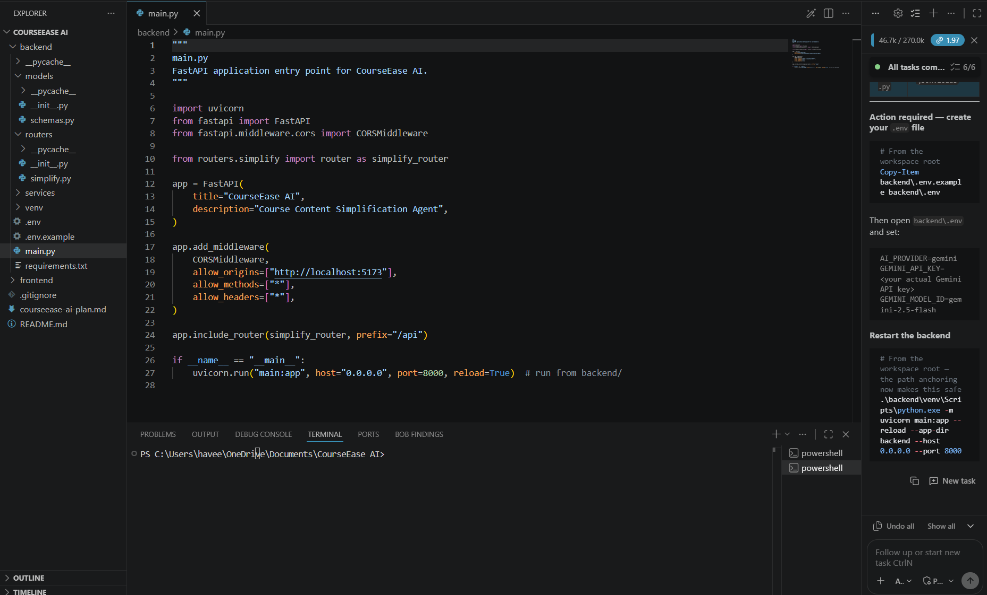
IBM Bob Screenshots:

Slide 8
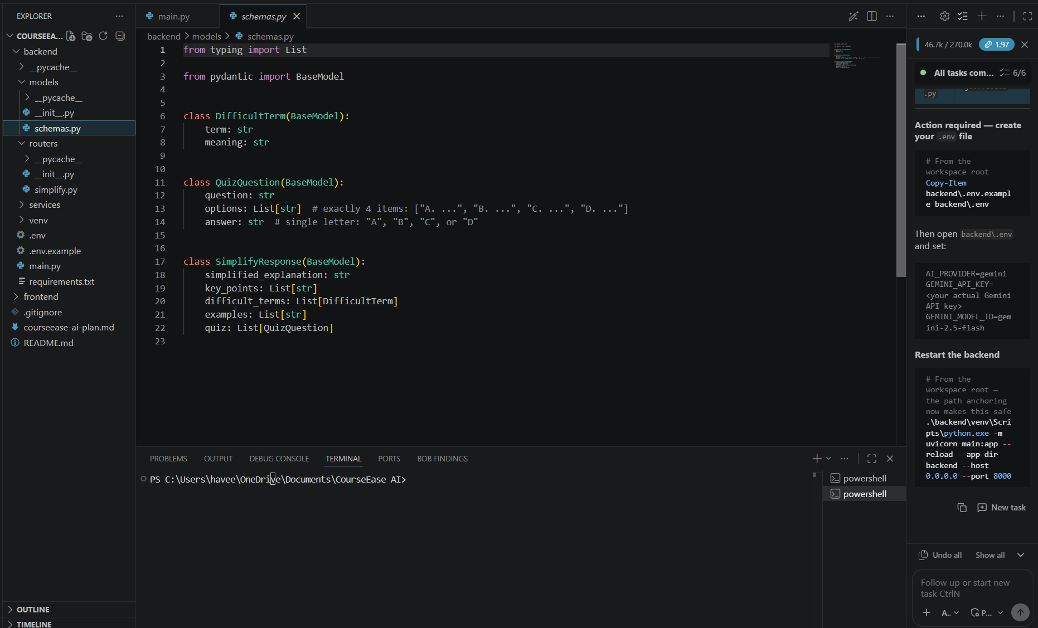

Slide 9

Role of Agentic AI in the solution
Agentic AI enables the Course Content Simplification Agent to function as an intelligent system rather than a simple chatbot. Using IBM watsonx.ai and IBM Granite models, it analyzes academic content and generates explanations according to the student's learning level.
The system performs different tasks such as analyzing course content, simplifying explanations, extracting key points, explaining difficult terms, generating examples, and creating quizzes.
This approach provides personalized learning, as the system adapts the explanation based on the selected proficiency level—Beginner, Intermediate, or Advanced.
Agentic AI also provides context awareness, using the uploaded course material as context so that the generated explanations and questions remain relevant to the given content.
The system can also perform multiple tasks from the same academic material, helping students understand concepts and test their knowledge through automatically generated MCQs.
Overall, Agentic AI makes the system personalized, context-aware, and learning-focused, acting as a smart academic learning assistant.

Slide 10
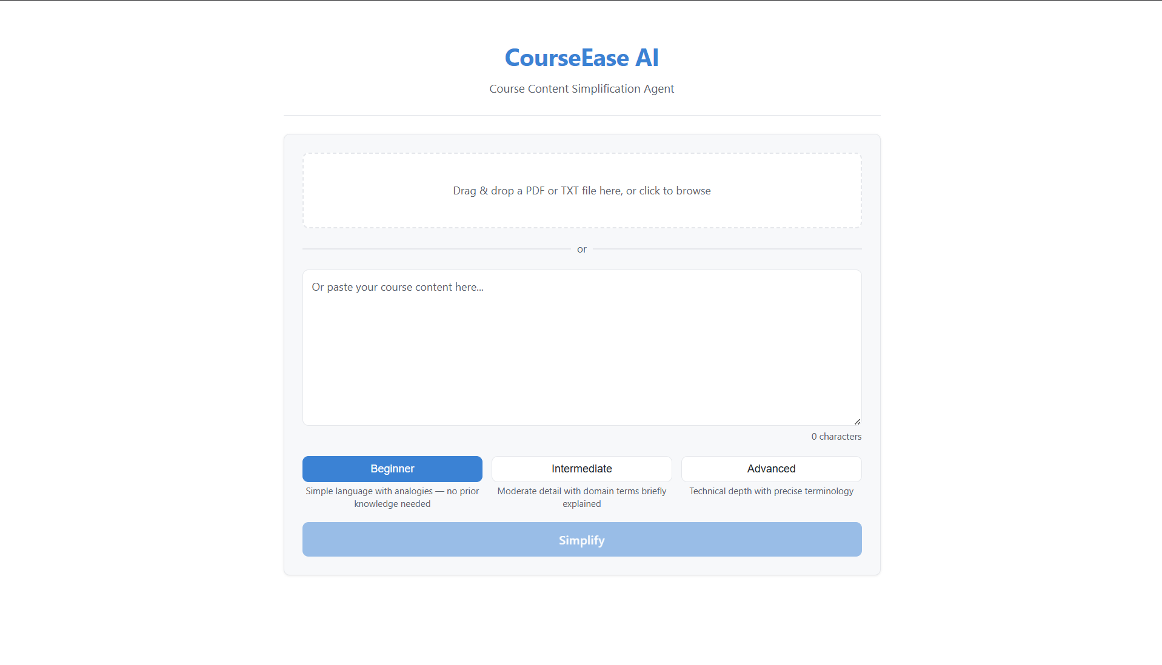
Project Output Screenshot
Please put IBM Bob output screenshots with 2-3 prompts.
You can take 2-3 more slides for each screenshot
·
·
·

Slide 11
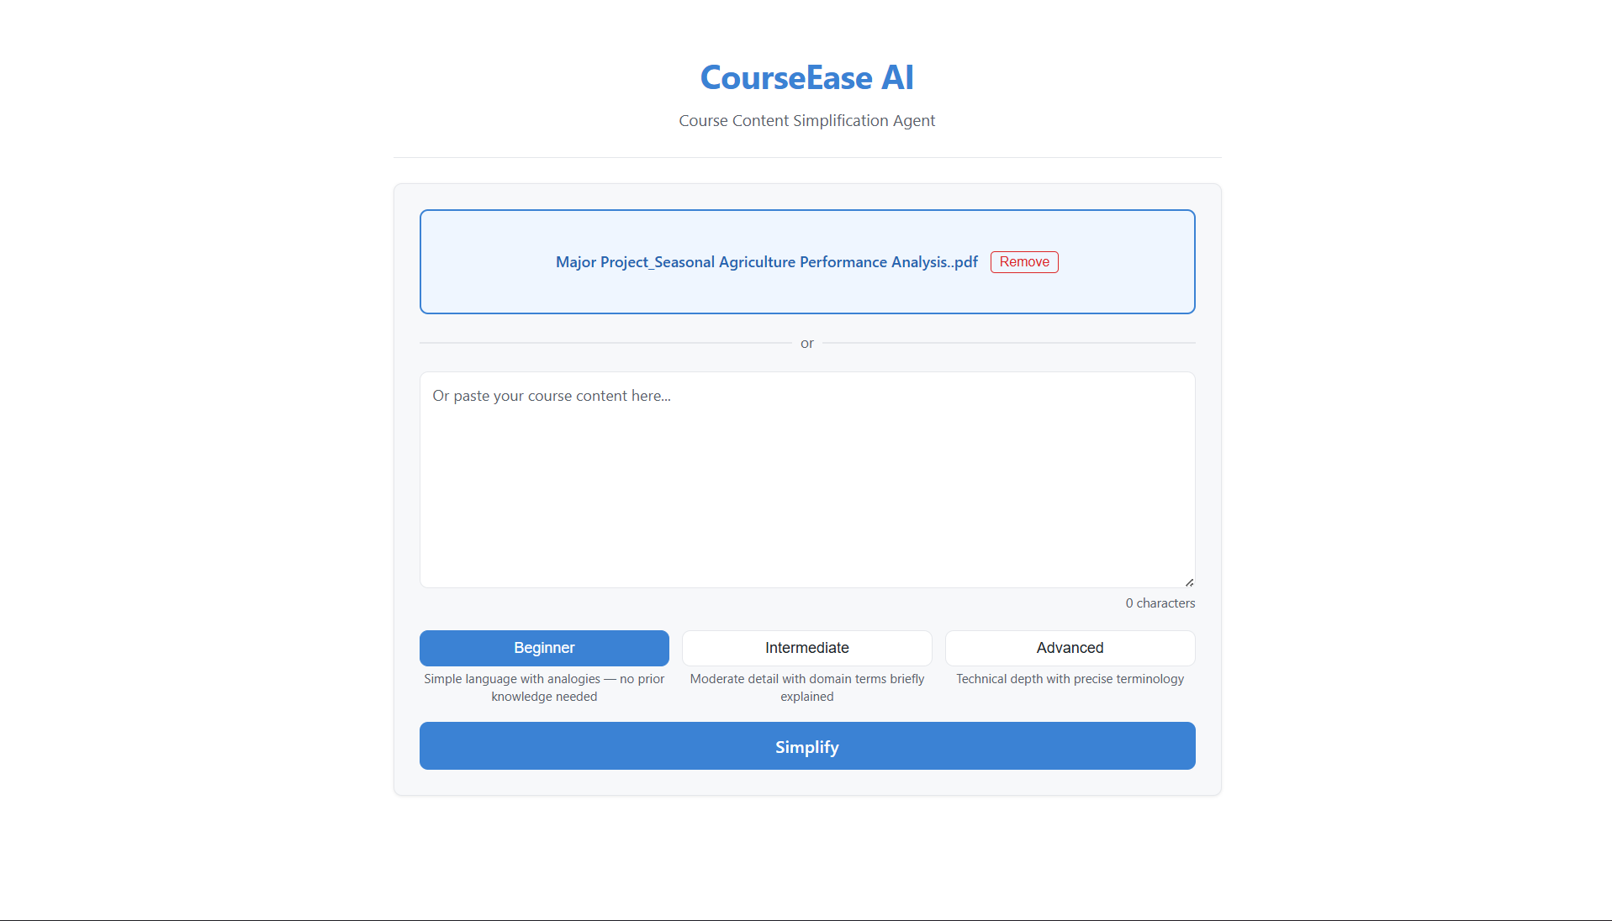
Project Output Screenshot
Please put IBM Bob output screenshots with 2-3 prompts.
You can take 2-3 more slides for each screenshot
·
·
·

Slide 12
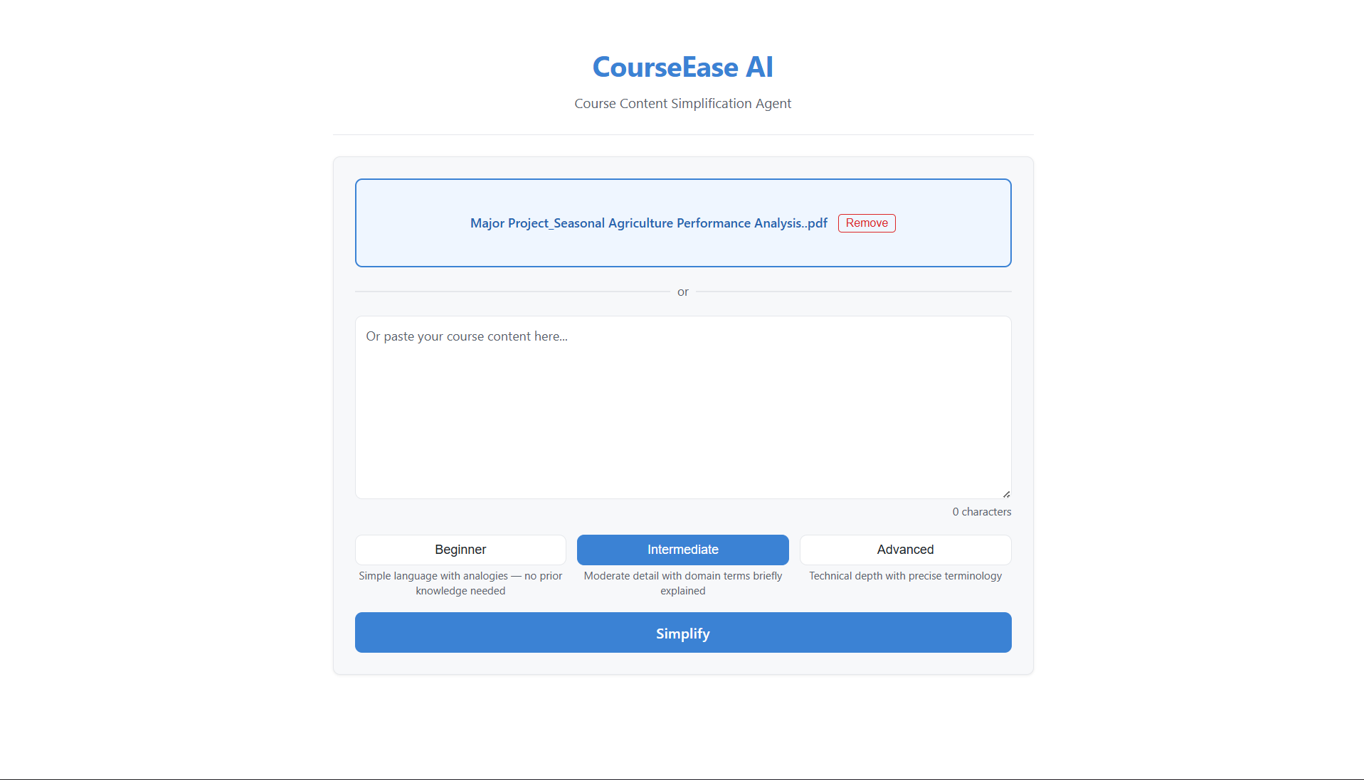
Project Output Screenshot
Please put IBM Bob output screenshots with 2-3 prompts.
You can take 2-3 more slides for each screenshot
·
·
·

Slide 13
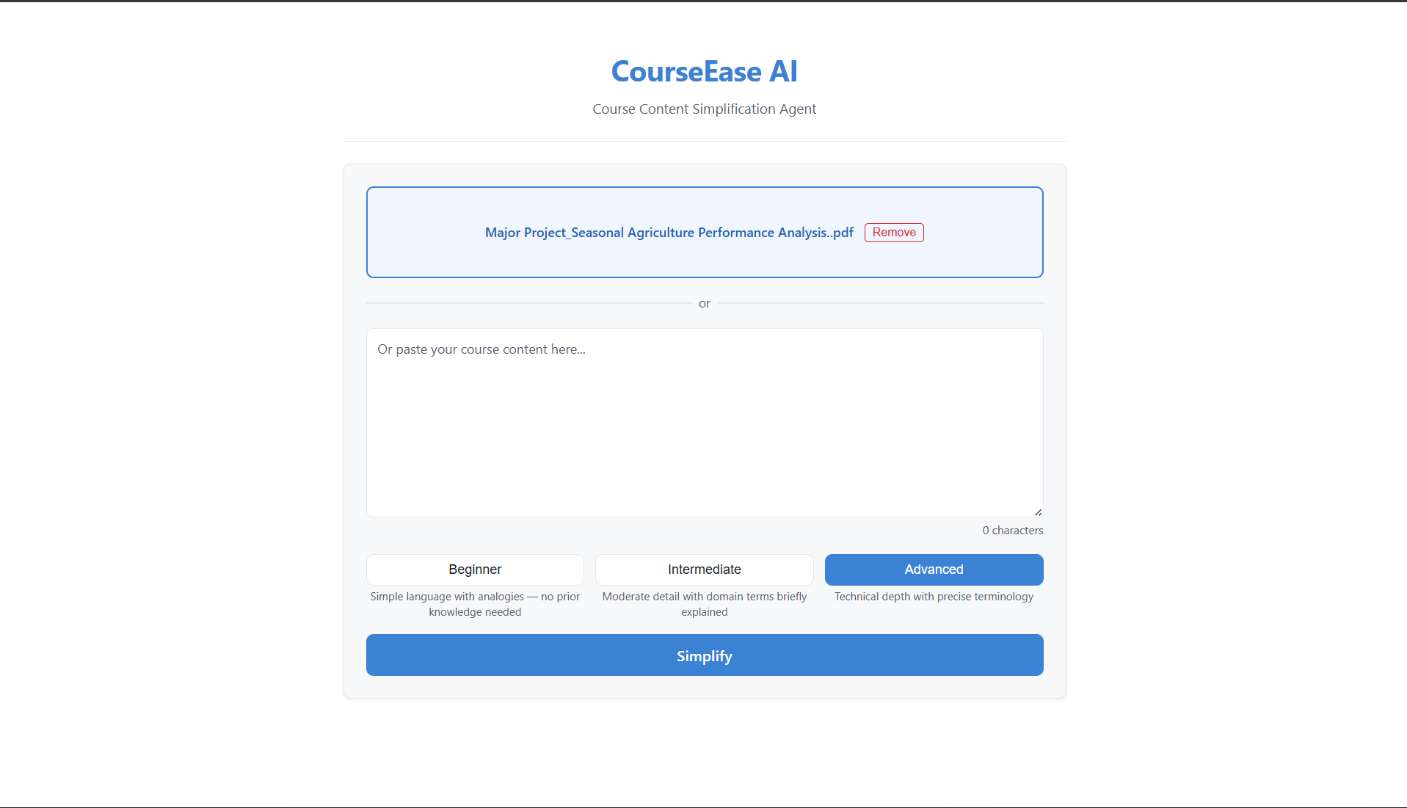
Project Output Screenshot
Please put IBM Bob output screenshots with 2-3 prompts.
You can take 2-3 more slides for each screenshot
·
·
·

Slide 14
Novelty and Uniqueness
The proposed Course Content Simplification Agent stands out by combining Agentic AI, RAG, and personalization into a single intelligent learning system.
Personalized Learning – Adapts explanations according to the student's level: Beginner, Intermediate, or Advanced.
RAG-Based Learning – Uses the uploaded course material as context to generate relevant and content-based explanations.
Intelligent Content Simplification – Converts complex and jargon-heavy academic content into clear and easy-to-understand explanations.
Key Point Extraction – Identifies the most important concepts from lengthy course materials.
Difficult Term Explanation – Detects technical terms and provides their simple meanings.
Relevant Examples – Generates examples related to the concepts in the provided course content.
AI-Generated Quiz – Creates 5 MCQs from the uploaded content and automatically evaluates the student's answers.
Multi-Format Input – Supports PDF, TXT, and pasted academic text.
IBM Granite Integration – Uses IBM Granite models through IBM watsonx.ai for content understanding and generation.
This makes the solution a personalized, context-aware, and interactive AI learning assistant, rather than just a basic text summarization tool.

Slide 15
Git Hub Link
· Please create public github repository (Enable Add README button while creating repository) with format –
Please test and Paste the working Github URL – https://github.com/Haveesh333/Course-Content-Simplification-Agent
Make sure you have Uploaded following three files into your github repository
1) All Agent relevant files of IBM Cloud , 2) yourproblemstatement.pdf file 3) your projectpresntation.pptx file 4)any other files
·
·
·

Slide 16
Future Scope
1. Integration with Learning Management Systems (LMS) –
The system can be integrated with platforms such as learning management systems to directly access course materials, assignments, and study resources. This will make personalized content simplification more convenient for students.
2. Multilingual Support & Voice Assistant –
Future versions can support multiple languages and voice-based interaction. This will improve accessibility and allow students to learn complex concepts through their preferred language and speaking mode.
3. Personalized Learning Progress Tracking –
The system can track student performance, quiz scores, and learning progress to provide more personalized explanations and identify topics that require additional attention.
4. Advanced Interactive Learning –
Future versions can generate flashcards, diagrams, concept maps, and practice questions from course materials, making learning more interactive and engaging.
5. Wider Academic Content Support –
The agent can be extended to handle textbooks, lecture notes, research papers, and other academic resources while adapting explanations to different educational levels.
·
·
·

Slide 17
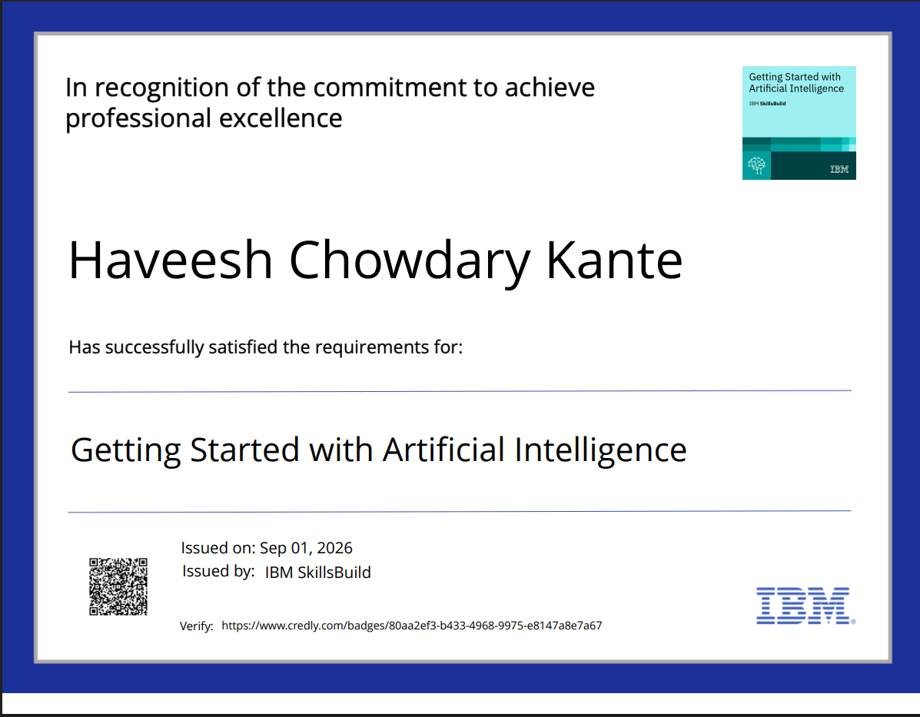
Certificates Earned:
Please add your credly certificate(Getting Started with Artificial Intelligence)

Slide 18
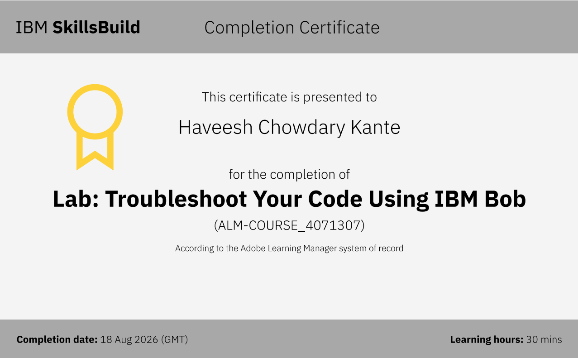
Certificates Earned:​
Add your IBM BOB Certificate

Slide 19


